Slide 1
Identifying Toxicity in Online Comments
Speed and scale
Anish Philip
W266 Final Project Presentation | Summer-2019 | Sat – 10:00AM

Slide 2
Online comments help us share ideas and make progress, but are they also one of the biggest tragedies of the internet ?
Many young victims of cyber bullying are not reporting these incidents
People involved in executing hate crimes have been known to leave some trail of toxic contents online
Many News Agency and other organization had to take down online comments sections due to an unsafe environment being built due to toxic comments
25%
Teenagers have been bullied repeatedly on online platforms
10%
of the articles is the most coverage that is being achieved by manual moderation

Slide 3
Toxic comments on any online platform can create unsafe environment that can discourage open discussion
How successful is the automation of flagged comments through AI algorithms like Google’s Perspective API ?
New York Times uses Tensor flow based perspective API solution to flag toxic comments
But moderators still have to accept or reject the suggestion made by the algorithm
More than 1000 flagged comments are reviewed daily by a team member

Slide 4
Many regular words/ terms referred in the toxic comments in an offensive way can cause the model to be biased risking transition of that bias to the user
Training data included: Comments from Wikipedia Talk Pages
Below are some words that occurred frequently in the toxic comments but
Gay
Article
Wikipedia
Dog
Jews
Developing strategies to identified these unintended biases are critical

Slide 5
My Objective for this project in terms of execution was to understand the typical workflow of an NLP project and importance of configuring various hyperparameters
“Hello NLP World”
Tweak the hyperparameters to get the most accurate word embeddings
Explore CNN, RNN, and LSTM models for this classification problem Toxic, Server toxic, Obscene, Threat, Insult, Identity hate
Leverage the Wikipedia data to train a model and then use it to classify the toxicity from NBA player’s Twitter account
Identify the correlation between player performance and Negative tweets

Slide 6
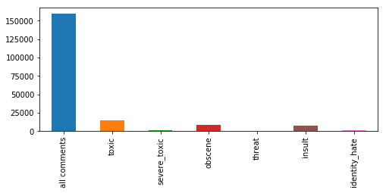
The data set used to train and test various toxicity identification models in this project is Wikipedia talk page comments from Jigsaw’s Kaggle contest from 2018
Other Data sets used outside model training
Almost 1M Tweets scrapped by leveraging official twitter handle of 381 NBA Players, 80 Media Partners, 30 Teams [Python’s Tweepy library]
60K player-game records from last 10 NBA seasons
0.5 M Random tweets
0.5 M IMDB movie reviews
Google Analogy data set
Min Accuracy for classification Toxic = 1; 90.41%
If all comments are considered as non-toxic

Slide 7
01
02
03
04
Word Embedding Models and accuracy
Identify Best Models for NBA Analysis
Load Data
Pre processing

Slide 8
RT @CloydRivers: Stupid is as stupid does. Feel The Bern. Merica. https://t.co/uK5z9UyNWm
RT @Real_DSGriffin: A good woman is a investment and a bad bitch is a bill. Thank you @iAmSJ #Realtalk
Tokenization
Case sensitivity
RT @LILBTHEBASEDGOD: IMA SEXY BITCH AND YOU CANT HAVE ME! MUAH BABY! LIL B IS BACK IN TOWN AND YES! "THE BASEDGOD" HAS MY FRONT AND BACK BI…
Pre Processing
['good', 'woman', 'investment', 'bad', 'bitch', 'bill', 'thank', 'realtalk']
Emoticons
Lemmatization
emoji_pattern = re.compile("["
u"\U0001F600-\U0001F64F" # emoticons
u"\U0001F300-\U0001F5FF" # symbols & pictographs
u"\U0001F680-\U0001F6FF" # transport & map symbols
u"\U0001F1E0-\U0001F1FF" # flags (iOS)
u"\U00002702-\U000027B0"
u"\U000024C2-\U0001F251"
"]+", flags=re.UNICODE)
Word | Lemma
Studies | Study
Studying | Study
Numbers, Special Char, Stop Words
‘is’, ‘am’, ‘are’, ‘this’, ‘a’, ‘an’, ‘the’

Slide 9
01
02
03
04
Word Embedding Models and accuracy
Identify Best Models for NBA Analysis
Load Data
Pre processing

Slide 10
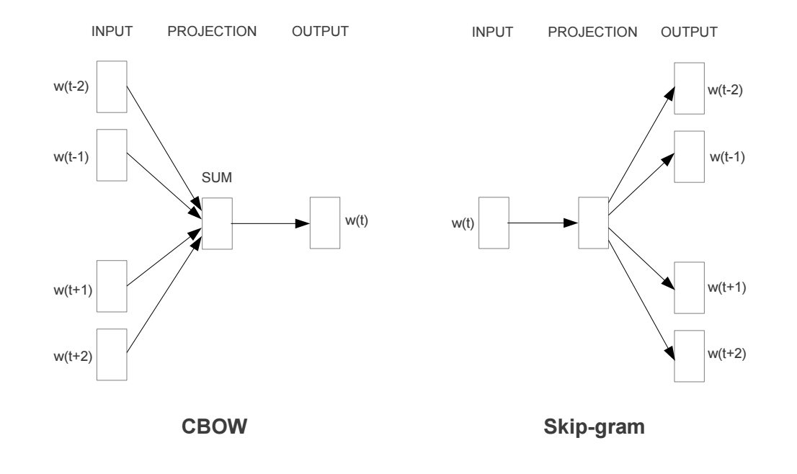
16 different Word2Vec embedding model were configured using the following corpus:
Almost 1M Tweets scrapped from NBA player, team and agent’s profile
0.5 M Random tweets
0.5 M IMDB movie reviews
0.32M Wikipedia comments
Word Embeddings
5
11
Performance assessment method:
Compare the accuracy against Google’s analogy dataset

Slide 11
Word2Vec model from genism library was leverage to generate 16 different predictive word embeddings (5 CBOW and 11 skip grams). Following parameters were modified to identify the best suited word embedding model:
Number of epochs: Number of training epochs/ iterations over the corpus
Min count: Ignores all words with total frequency lower than this
Vector size: Number of dimensions that a word is represented as
Window size: Maximum distance between the current and predicted word within a sentence
Model Type: CBOW or Skip-gram: Skip-gram tries to predict the surrounding words given a context word whereas CBOW does the opposite
Word Embeddings

Slide 12
Skip-gram models
Model | Epochs | Min. word Freq | Vec Size | Window
Model 6 | 10 | 1 | 200 | 5
Model 7 | 20 | 2 | 200 | 10
Model 8 | 10 | 2 | 200 | 15
Model 9 | 20 | 1 | 200 | 15
Model 10 | 20 | 2 | 200 | 15
Model 11 | 20 | 1 | 300 | 15
Model 12 | 20 | 1 | 100 | 15
Model 13 | 20 | 2 | 300 | 15
Model 14 | 20 | 5 | 200 | 15
Model 15** | 20 | 2 | 200 | 15
Model 16** | 20 | 2 | 200 | 15
CBOW models
Model | Epochs | Min. word Freq | Vec Size | Window
Model 1 | 10 | 1 | 200 | 1
Model 2 | 20 | 1 | 200 | 5
Model 3 | 10 | 1 | 200 | 15
Model 4 | 10 | 1 | 300 | 15
Model 5 | 10 | 2 | 300 | 15
Word Embeddings
Observation: Longer vector representation doesn’t necessarily add more accuracy
Skip-Gram performed better, but took longer time to execute
**Model 15 and 16 have additional data. Model 15 considers an additional set of imdb movie reviews and 16 has random Tweets plus the regular training data including imdb data

Slide 13
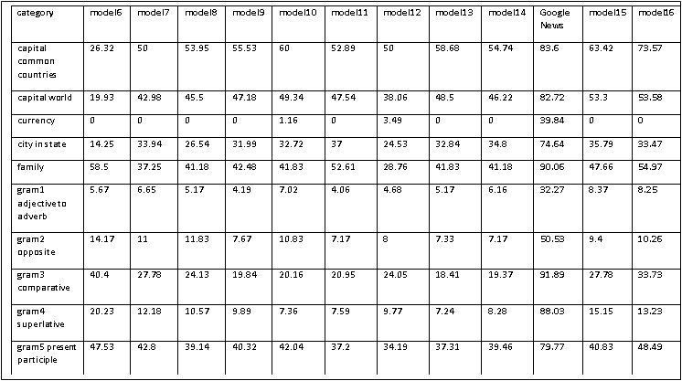
% match in Google Analogy data set test (Skip-gram models)
model16_moretweets = w2v(data_more_tweet_df['tokens'], 20, 2, 200, 15, 1, 'model16_moretweets.bin')
Word Embeddings

Slide 14
01
02
03
04
Word Embedding Models and accuracy
Identify Best Models for NBA Analysis
Load Data
Pre processing

Slide 15
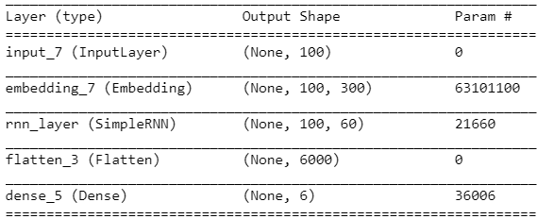
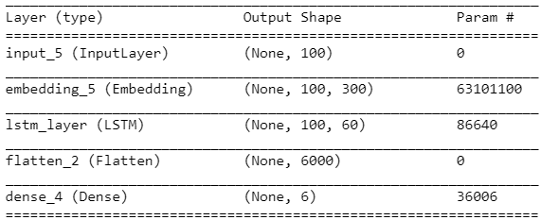
Evaluation Parameters:
Precision = True Positive/ (True Positive + False Positive)
Accuracy = (True Positive + True Negative)/ (True Positive + True Negative + False Positive + False Negative)
Model Configuration
Baseline Models (Max seq length = 100)
Simple RNN
Simple LSTM
Trained using pretrained Word2Vec GoogleNews-vectors and Wikipedia training and test data

Slide 16
Baseline Performance
Simple RNN
Simple LSTM
Category | Accuracy | Precision
Toxic (N=6,088) | 91.77% | 61.44%
Server toxic (N=367) | 99.3% | 35.82%
Obscene (N=3689) | 95.19% | 62.78%
Threat (N=211) | 99.6% | 17.57%
Insult (N=3425) | 94.89% | 53.25%
Identity hate (N=712) | 98.81% | 27.52%
Category | Accuracy | Precision
Toxic (N=6,088) | 93.19% | 62.85%
Server toxic (N=367) | 99.33% | 36.44%
Obscene (N=3689) | 96.47% | 73.14%
Threat (N=211) | 99.67% | 51.73%
Insult (N=3425) | 96.21% | 69.9%
Identity hate (N=712) | 98.93% | 56.7%
Model Configuration
Single layer LSTM performed slightly better than simple RNN in terms of accuracy and much better in terms of Precision
LSTM and RNN hidden Layer = 60
Recurrent dropout (0.1) tuned ON
Epochs = 3; Note: At 10 there was a increase in validation error and decrease in validation accuracy due to overfitting

Slide 17
Model Iteration:
Word embedding mode16, Vector size = 200
max length of word/ tokens/ record = 100
Model | Toxic |  |  | Obscene |  |  | Insult
 | Accuracy | Precision | Recall | Accuracy | Precision | Recall | Accuracy | Precision | Recall
CNN | 90.83% | 53.35% | 29.85% | 94.69% | 56.77% | 33.88% | 94.81% | 52.8% | 30.6%
Simple RNN | 90.62% | 64.63% | 76.28% | 94.89% | 71.06% | 68.19% | 94.03% | 61.72% | 65.64%
Simple LSTM | 92.74% | 59.87% | 72.16% | 96.05% | 64.86% | 69.1% | 95.89% | 61.89% | 60.7%
Bi-Directional LSTM | 92.81% | 59.94% | 74.06% | 96.2% | 66.63% | 68.53% | 96.03% | 64.0% | 59.27%
Bi-Directional LSTM with Conv layers | 93.09% | 61.72% | 72.49% | 95.89% | 62.31% | 72.81% | 96.33% | 68.41% | 58.69%
Stacked LSTM | 93.26% | 63.22% | 69.94% | 96.32% | 68.42% | 67.2% | 95.79% | 62.92% | 52.41%
Model Configuration

Slide 18
Classify Tweets of NBA players (Identify the best model)
Max len = 10 (number of words/ tokens per train and test record)
Train on smaller comments N<20 because tweets are small in length
Evaluation Parameters | model6 | model7 | model8 | model9 | model10 | model11 | model12 | model13 | model14 | model15 | model16 | model17
Toxic Precision | 68.97% | 63.59% | 64.1% | 65.41% | 64.63% | 70.43% | 71.93% | 75.92% | 79.6% | 67.21% | 65.82% | 70.15%
Toxic Accuracy | 90.99% | 90.39% | 90.47% | 90.69% | 90.62% | 91.52% | 91.54% | 91.57% | 89.44% | 90.99% | 90.71% | 91.32%
Toxic Recall | 67.54% | 77.12% | 76.2% | 74.3% | 76.28% | 70.33% | 67.19% | 60.31% | 35.35% | 72.45% | 73.24% | 68.67%
Obscene Precision | 71.66% | 63.63% | 68.81% | 66.63% | 71.06% | 71.84% | 68.71% | 76.74% | 74.53% | 66.74% | 65.21% | 62.64%
Obscene Accuracy | 94.95% | 94.23% | 94.63% | 94.62% | 94.89% | 94.96% | 94.73% | 95.08% | 94.17% | 94.5% | 94.4% | 93.97%
Obscene Recall | 68.03% | 76.64% | 68.44% | 74.7% | 68.19% | 67.9% | 70.83% | 61.19% | 48.83% | 71.69% | 74.54% | 73.84%
Insult Precision | 58.81% | 51.62% | 57.17% | 67.53% | 61.72% | 66.7% | 62.66% | 74.39% | 61.0% | 64.51% | 55.23% | 63.51%
Insult Accuracy | 93.5% | 92.42% | 93.39% | 94.46% | 94.03% | 94.35% | 93.8% | 94.4% | 93.11% | 94.19% | 93.07% | 94.11%
Insult Recall | 60.75% | 73.16% | 67.07% | 58.3% | 65.64% | 57.77% | 54.29% | 45.13% | 36.89% | 59.77% | 67.96% | 60.79%
Model Configuration

Slide 19
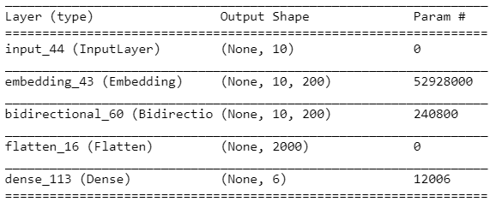
Model 13 is a simple Bidirectional LSTM with 100 Hidden nodes, loss function = binary cross entropy, Adam optimizer and Sigmoid activation at output layer
Model Configuration
Model6 - Bidirectional LSTM with 1 Conv/ Max Pool and 3 dense layer
Model7 - Bidirectional LSTM with 1 Conv/ Avg Pool and 3 dense layer
Model8 - Only Bidirectional and 3 dense layer
Model9 - 2 Stacked bidirectional
Model10 - 2 Stacked bidirectional with 1 conv layer/ avg pool
Model11 - 2 Stacked bidirectional with 1 conv/ avg pool and 2 dense layer
Model12 - 3 Stacked bidirectional with 1 conv/ avg pool and 4 dense layer
Model13 - Bidirectional LSTM
Model14 - Simple RNN
Model15 - Simple LSTM

Slide 20
Overall 5000 out of 1M tweets were classified into one of the toxicity class
About 65 players had negative and non-negative tweets
By the measure of score/ min. – On an average these players scored 15% lower around the days when they received/ or sent a negative tweet/ RT than in the game when they did not receive a negative tweet
Around the days of negative tweet 4.6 points/ 10 mins.
At least 1-2 months away from the negative tweet 3.9 points/ 10 mins
This differentiation increases when we look at the most recent 5 seasons
NBA Player Performance

